Slide 1

From Fingerstick blood glucose samples to the predictive power of continuous glucose monitoring
Alessia Bruzzo, Antoine Biebuyck, Nathan Hoffman

Slide 2

Motivation
~90%
Patients with type II [1]
Less than half
537 Million
Meet glycemic targets [2]
Adults (20-79) in 2021 [1]
79.4%
Only 1 in 4
Live in low- & middle- income countries [1]
Insulin-treated T2D use CGM [2]
3 Times
Price of CGM versus finger prick in US study [3]
2
Notes:
1 minute in.

Slide 3
Methods
Pre-processing
Created a framework so that the preprocessing steps can also be used for applying on ML/DL models.
Performs multiple feature engineering steps such as:
Adds features related to timing of fingerstick measurement, meal events and insulin boluses.
Calculates the blood glucose rate of change over 5 and 15 minutes.
Can scale the whole data set between 0 and 1.
Lagged features are also generated.
Sampling rates can be easily changed and adapted.
3

Slide 4
Methods
Creation of Time Series
Critical aspect of the framework to generate time series:
Identification of events performed during large meal intake.
A carb input is found in the data set.
Checks for presence of associated with carb intake such as fingerstick measurement and insulin bolus within a window of 10 minutes.
If condition is met, starting from the earliest event in the window, samples are taken all 5 minutes and a time series is generated over a 4-hour period .
The framework can as such also be used to produce time series for ML/DL models.
4

Slide 5

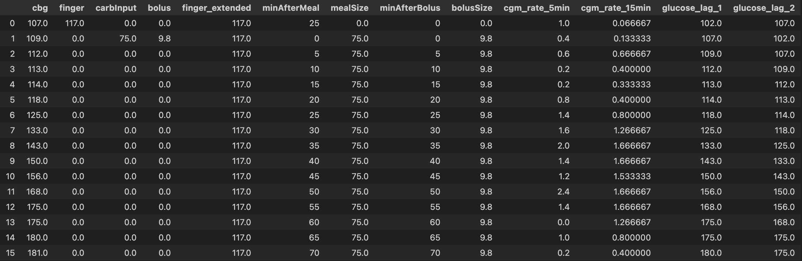
Methods
Creation of Time Series
5

Slide 6
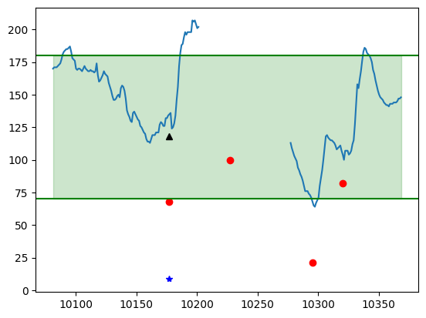
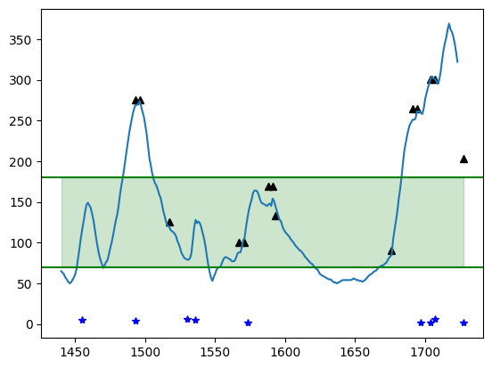
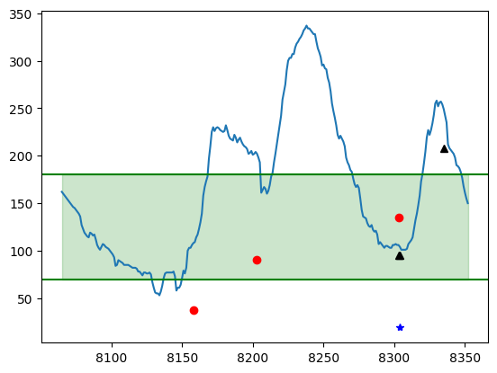
Methods
6
Notes:
Rather messy data between patients:
Missing meals or fingerstick measurements
Time of insulin boluses between patients varied a lot (10-50mins) and boluses alone were used to correct hyperglycemia.
Expectation of certain signal after carb intake. However, this was not the case.
Peak of blood glucose should arrive 90 minutes after carb intake
red: carb intake
Blue : bolus
Black : fingerstick
One sample = 5 minutes

Slide 7
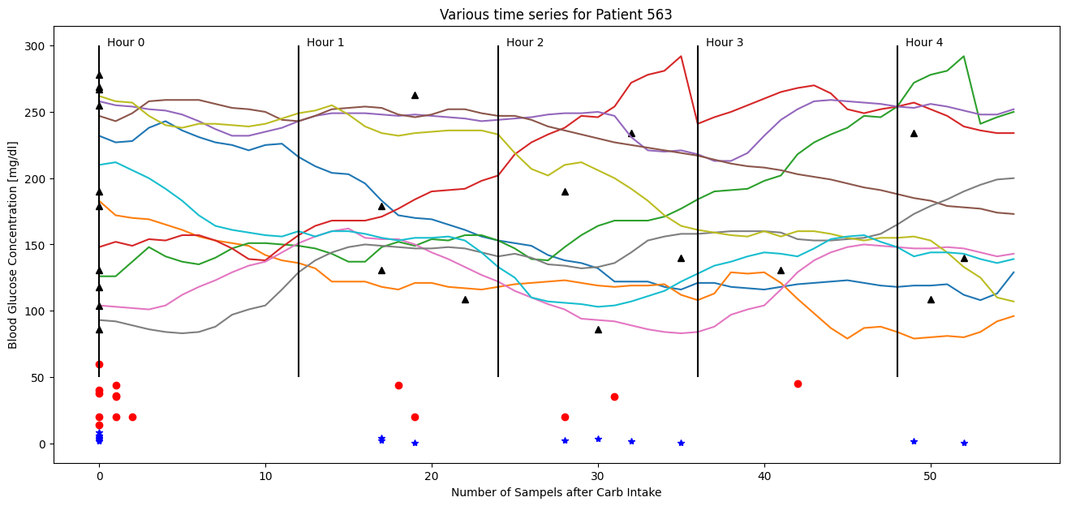
Methods
6
Notes:
Rather messy data between patients:
Missing meals or fingerstick measurements
Time of insulin boluses between patients varied a lot (10-50mins) and boluses alone were used to correct hyperglycemia.
Expectation of certain signal after carb intake. However, this was not the case.
Peak of blood glucose should arrive 90 minutes after carb intake
red: carb intake
Blue : bolus
Black : fingerstick
One sample = 5 minutes

Slide 8
Interpolation Methods
Cubic Spline
Process of constructing a spline (function values of an interpolation function) within a certain interval and consists of n polynomials of degree 3 [6]
Polynomial of degree 5
A single polynomial function with a highest order of 5
Subsampling rates
1, 2, 4, 8, 16, 32
7
Notes:
4 minutes in.

Slide 9
metrics
Mean Blood glucose level
Current gold standard for determining management [4] :
A1C measures average blood glucose over previous months [4]
Target is less than 154 mg/dL [5]
Time In range
Healthy range considered 70-180 mg/dL and aim is to spend 70% of time in this range [4]
Below is hypoglycemia and above is hyperglycemia
More time spent in range, less likely to develop complications [4]
8
Notes:
Why clinically relevant
A1C
5.30 minutes in.

Slide 10
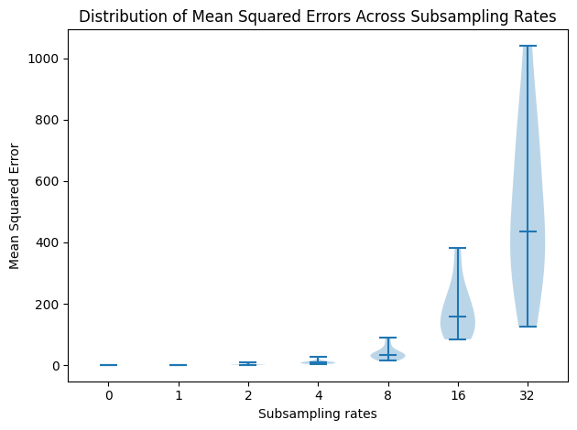
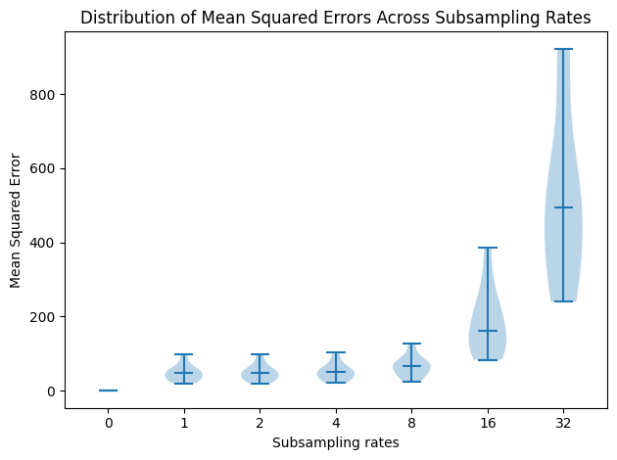
Mean Squared Error
CubiC Spline
Polynomial Degree 5
9

Slide 11
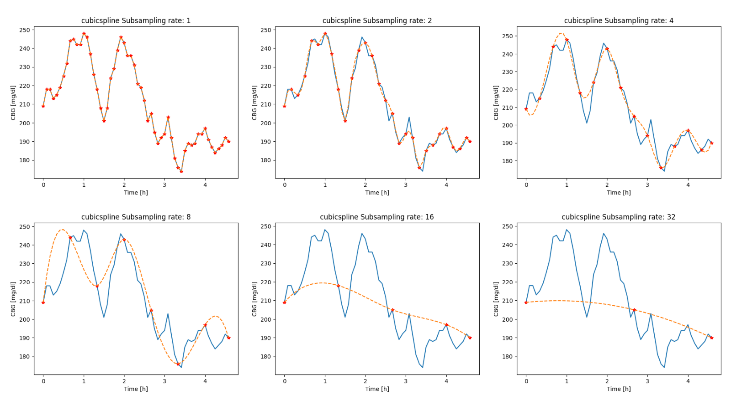
Reconstructed Signal
10

Slide 12
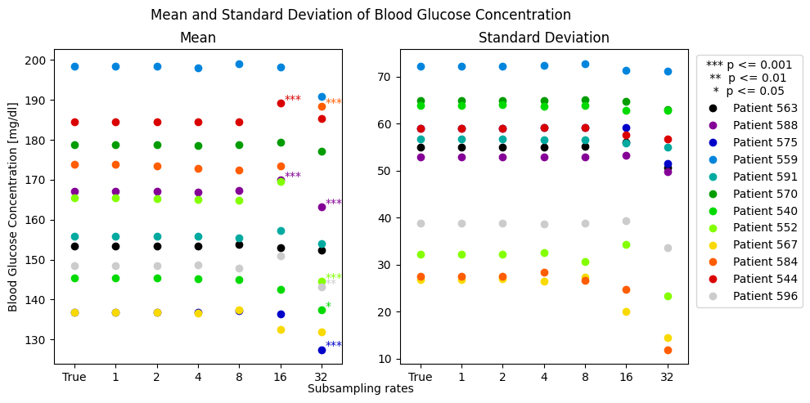
Mean blood glucose level
11
Notes:
Low sampling rates keeps up pretty well, high sampling rates it drastically decrease (all greens) -> the patient is not fine
Orange goes up, mention interpatient variability
Std decreases -> the peaks are not followed anymore -> variability of BG cannot be found

Slide 13
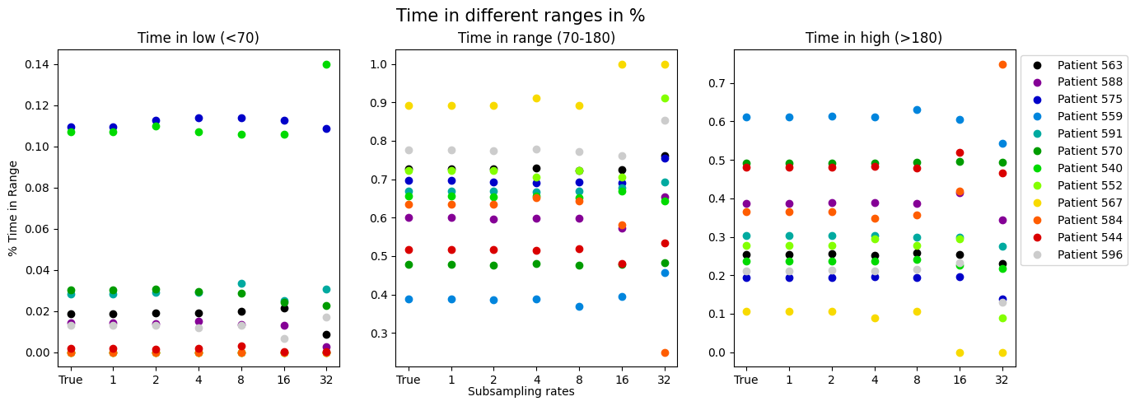
Time in range
12
Notes:
8.30 minutes in

Slide 14
Conclusions
Satisfactory reconstructions up until intervals of 40 minutes
Would therefore require 24 finger prick samples a day
Not quite convenient and likely unsustainable
13

Slide 15
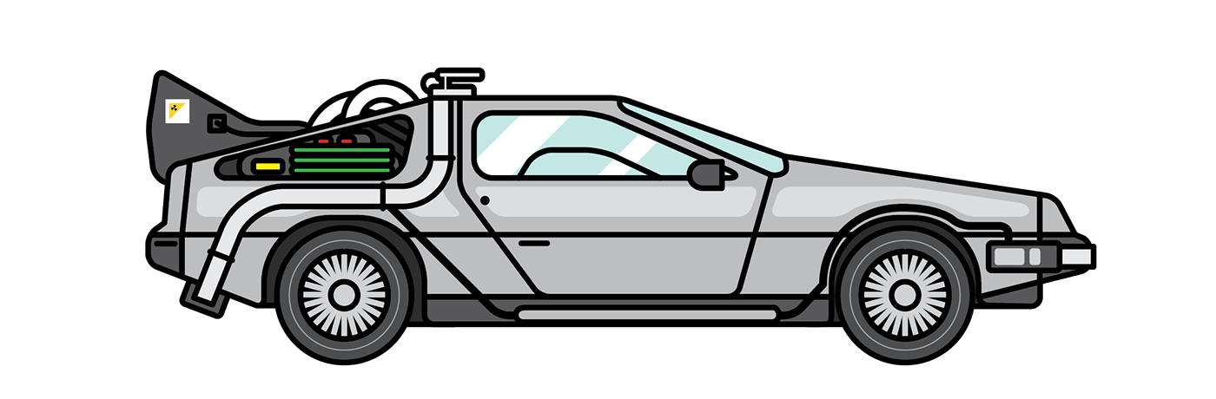

Future directions
Adaptive or dynamic subsampling
Using additional features that can be measured non-invasively using wearables
Use of artificial intelligence and machine learning
14
Notes:
Higher around meal
Wearables : because we know multiple features affect BG level
10 minutes in.

Slide 16
Thank you !
Any Questions ?
15

Slide 17
References
[1] Home et al., “IDF Diabetes Atlas.” Accessed: Dec. 14, 2024. [Online]. Available: https://diabetesatlas.org/
[2] L. S. Mayberry, C. Guy, C. D. Hendrickson, A. B. McCoy, and T. Elasy, “Rates and Correlates of Uptake of Continuous Glucose Monitors Among Adults with Type 2 Diabetes in Primary Care and Endocrinology Settings,” J GEN INTERN MED, vol. 38, no. 11, pp. 2546–2552, Aug. 2023, doi: 10.1007/s11606-023-08222-3.
[3] W. Wan et al., “Cost-effectiveness of Continuous Glucose Monitoring for Adults With Type 1 Diabetes Compared With Self-Monitoring of Blood Glucose: The DIAMOND Randomized Trial,” Diabetes Care, vol. 41, no. 6, pp. 1227–1234, Jun. 2018, doi: 10.2337/dc17-1821.
[4] American Diabetes Association. CGM and Time in Range, American Diabetes Association. url: https : / / diabetes . org / about - diabetes / devices-technology/cgm-time-in-range.
[5] “Understanding A1C Test | ADA.” Accessed: Dec. 14, 2024. [Online]. Available: https://diabetes.org/about-diabetes/a1c
[6] “Cubic Spline Interpolation - Timo Denk’s Blog.” Accessed: Dec. 14, 2024. [Online]. Available: https://blog.timodenk.com/cubic-spline-interpolation/
16

